Slide 1

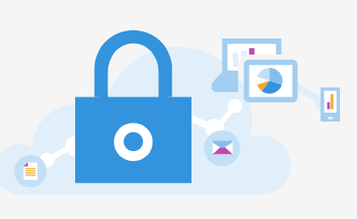
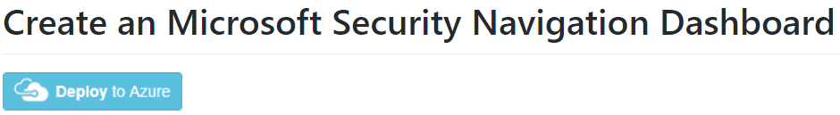
Portal URLs
Microsoft Sentinel (SIEM + SOAR)
Azure Active Directory Identity Protection
(AADIP)
Microsoft Defender for Office 365
Office 365 Advanced Threat Protection
(O365 ATP)
Microsoft Defender for Cloud Apps
(MCAS)
(CASB)
Microsoft Defender for Cloud
(Azure Security Center)
(Azure Defender)
Microsoft Defender for Identity
Azure Advanced Threat Protection
(Azure ATP)
Microsoft Defender for Endpoint
Microsoft Defender ATP
(MDATP)
Azure Information Protection
(AIP)
Microsoft 365 Security Center
Notes:
Can help with the different portal URLs one may have to navigate through for each Microsoft and Azure Security product. You can also upload a Azure Portal Dashboard here: https://github.com/swiftsolves-msft/dashboards/tree/master/MicrosoftSecurityNavigation
Changes Occurring: 9/22/2020
https://www.microsoft.com/security/blog/?p=91813
Portal Docs: https://docs.microsoft.com/en-us/microsoft-365/security/mtp/portals?view=o365-worldwide

Slide 2
























Free Logs and Alerts + E5 Offer 5mb/per user/per day toward data
Microsoft Sentinel (SIEM + SOAR)
ALERTS
ALERTS
LOGS
LOGS
Microsoft 365 Security Center
Microsoft Defender for Cloud
AAD
Microsoft 365 Defender
O365
Azure
Cloud Security Posture Management (CSPM)
Azure Defender
(CWPP)
SignIns
Audits
MDE Advanced Hunting
EXO
SPO
OD4B
Teams
Activity Logs
Identities
Endpoints
Data & Email
Cloud Apps
Azure Active Directory Identity Protection
(AADIP)
Office 365 EmailDelivery
PaaS Audit
Microsoft Defender for Endpoint
(MDATP)
Microsoft Defender for O365
(O365 ATP)
Microsoft Defender for Cloud Apps
(MCAS)
(CASB)
Identity
(coming soon)
Microsoft Defender for Identity
(Azure ATP)
Microsoft Defender for Cloud Apps
(MCAS)
(CASB)
Microsoft Defender
365
(MDATP)
(Threat Hunting)
Cloud Apps
(coming soon)
Microsoft Defender for Cloud Apps
(MCAS)
(CASB)
Azure Information Protection
(AIP)
Alert Evidence
(coming soon)
Notes:
Walk through and explain what alerts are Free (Left Side) and what Raw Logs are Free (Right side)
https://azure.microsoft.com/en-us/offers/sentinel-microsoft-365-offer/

Slide 3
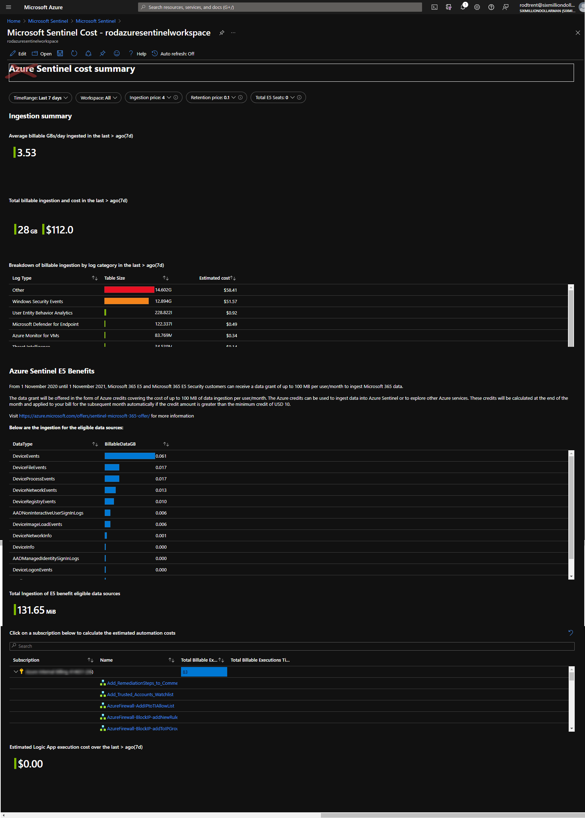
Leverage Microsoft Sentinel Cost Workbook

Slide 4
Azure Sentinel
Pricing sheet - Rudnei Oliveira
Ver 0.1
^{8/2nd}

Slide 5

Ingestion examples:
No Cost with Log/Alert ingestion:
O365 Activity logs
Azure Activity logs
Microsoft Defender for Cloud Alerts
Azure DDoS and WAF Alerts
Microsoft Defender for Endpoint Alerts
Microsoft Defender for Identity Alerts
Microsoft Defender for Office 365 Alerts
Identity Protection Alerts
Microsoft Defender for Cloud Apps Alerts
* This list may change without notification.
$
Microsoft Sentinel
Pricing sheet
(VM cost)
$
Palo Alto
(cost per GB ingested)
Syslog / CEF Gw
(VM)
Cisco
$
Threat Intel
$
(all costs involved)
MDATP
Azure
O365
Sentinel Features:
Costs:
VM
Depends on the data ingested by the connector
$
Data Connector
VM
$
(cost per GB ingested)
Analytic Queries
No Cost
VM
Just in case you have those data ingested.
Log Analytics
(workspace)
Diag
Logs
(others)
Microsoft Sentinel
Hunting Queries
No Cost
Workbooks
No Cost
Notebooks
$
Notebook usage cost
On-premises
$
Playbooks
Logic App cost
VM
$
(cost per GB ingested)
Official Pricing References:
Microsoft Sentinel - https://azure.microsoft.com/en-us/pricing/details/azure-sentinel/
Log Analytics - https://azure.microsoft.com/en-us/pricing/details/monitor/
Logic Apps - https://azure.microsoft.com/en-us/pricing/details/logic-apps/
VM - https://azure.microsoft.com/en-us/pricing/details/virtual-machines/linux/
Notebooks - https://docs.microsoft.com/en-us/azure/notebooks/azure-notebooks-overview#pricing-and-quotas
VM
Just in case you have those data ingested.
VM
* This is not an official pricing reference. Azure Sentinel official pricing page (link above) is the most accurate information.

